Slide 1

Vel Tech Rangarajan Dr. Sagunthala R&D Institute of Science and Technology
School of Computing
Department of Computer Science and Engineering
10211CS224 / FULL STACK APPLICATION DEVELOPMENT (JAVA)
PROJECT REVIEW : MILESTONE PROJECT – 1
Date: 25-03-2026
Dynamic Online Examination & Result Processing System
SDG: 4,8 – Quality Education, Decent Work and Economic Growth
Presented By:
T.Akhil Nandhan – VTU25836 – 23UECS0560
Courses Handling Faculty:
Dr. Sumithra M. – ASSISTANT PROFESSOR(SG)

Slide 2
INTRODUCTION
The Online Exam System is a web-based application for conducting exams digitally.
It eliminates the need for traditional paper-based examinations
Students can take exams anytime and anywhere using a web browser.
The system provides secure login and user authentication.
It includes features like question management, timer-based exams, and automatic evaluation.
Results are generated instantly after exam submission.
It reduces manual work, time consumption, and human errors.
The system is developed using PHP, MySQL, HTML, CSS, and JavaScript.
It is simple, efficient, and user-friendly for both students and administrators.
1
2
3
4
5
6
7
8
9

Slide 3
PROBLEM STATEMENT
1
In traditional examination systems, the entire process is carried out manually, which makes it time-consuming and inefficient. The preparation of question papers, distribution, and evaluation of answer sheets require significant effort and resources. Manual checking of papers often leads to human errors, affecting the accuracy and reliability of results. Additionally, the process of result generation is slow, causing delays for students.
Paper-based exams also involve high costs due to printing and require proper storage and management of physical records, which can be difficult to maintain and prone to damage or loss. Moreover, traditional systems lack flexibility, as students must be physically present to attend exams, making it inconvenient in certain situations.
There is also a lack of proper security in handling question papers and answer sheets, increasing the risk of malpractice. Furthermore, tracking student performance and maintaining records manually is complex and inefficient. Therefore, there is a need for an automated, secure, and efficient system that can simplify the examination process and provide quick and accurate results.
2
3
4
5
6
7
8
9

Slide 4
OBJECTIVE(S)
1
2
To develop a web-based platform for conducting online exams.
To provide secure user authentication (login & registration).
3
4
5
6
7
8
9

Slide 5
PROPOSED SYSTEM
Complete Online Exam Solution - The Online Exam System is a web-based platform designed to conduct examinations digitally. It provides features such as user registration, login, question management, timed exams, and automatic result generation—everything needed for a modern examination system.
Dynamic Question Management - Questions are stored in a MySQL database and displayed dynamically during the exam. Admin can easily add, update, or delete questions.
Secure User Authentication - The system includes a secure login and registration module with session management. It ensures that only authorized users can access the exam and prevents unauthorized access.
Timer-Based Examination - Each exam is conducted with a predefined time limit. The system automatically submits the exam when the time is completed.
Automatic Evaluation & Instant Results – The system automatically evaluates answers and generates results instantly after submission, ensuring accuracy and saving time.
Data Management-All student details, questions, and results are stored securely in the database, making it easy to manage and retrieve information.
1
2
3
4
5
6
7
8
9

Slide 6
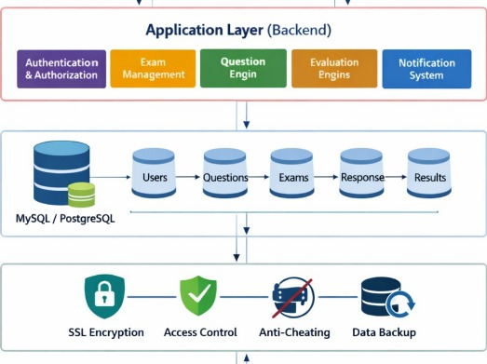

PROPOSED SYSTEM ARCHITECTURE
1
2
3
4
5
Component | Definition
INPUT | User actions like clicks, form submissions, and page requests that trigger the system
PROCESSING | PHP logic that validates, calculates, and decides what action to take based on input
DATABASE | MySQL storage that permanently saves and retrieves user data, products, and wishlist items
OUTPUT | Dynamic HTML pages, success/error messages, and updated content displayed to user
6
7
8
9

Slide 7
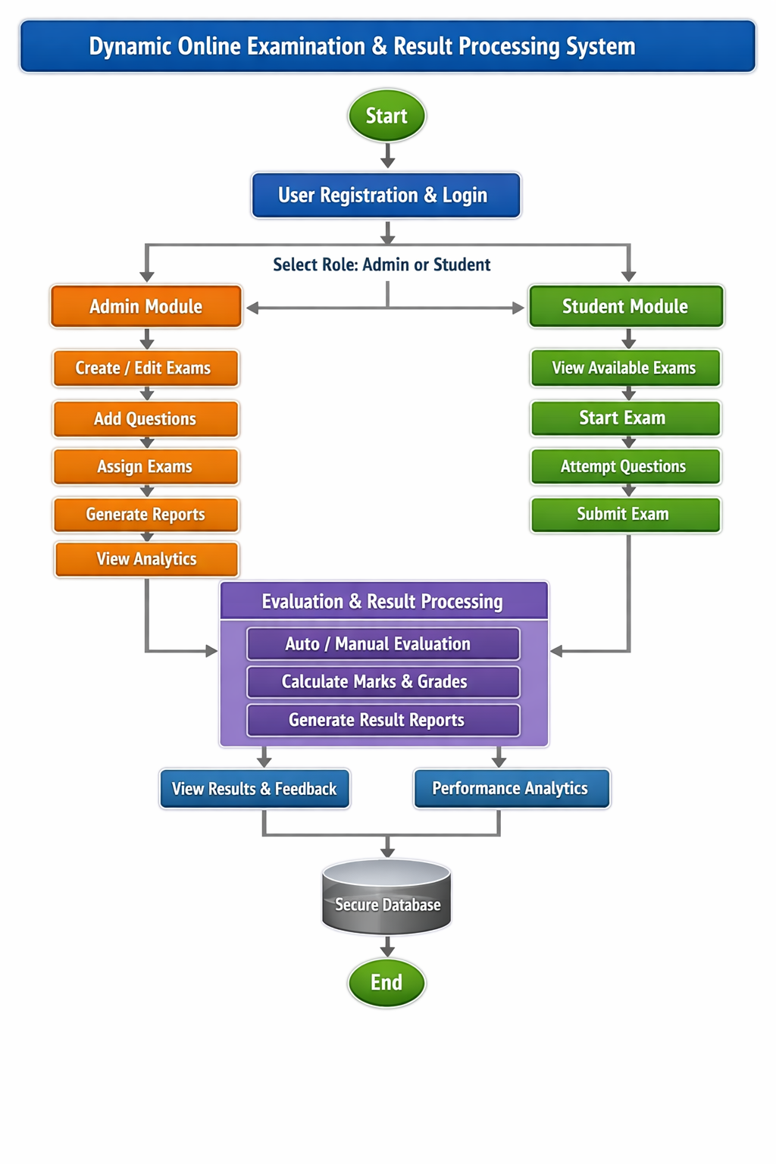

WORKFLOW
1
2
3
4
5
6
7
8
9

Slide 8
TECHNOLOGIES USED
FRONTEND – HTML5 , CSS , JavaScript
BACKEND - PHP
DATABASE – MySQL (phpMyAdmin)
TOOLS – XAMPP , Visual Studio Code , Google Chrome
HARDWARE REQUIREMENTS - Intel Core i3 Processor, 4GB RAM
SOFTWARE REQUIREMENTS - Windows/Linux/macOS , Apache Server , PHP 7.4+ , MySQL 5.7+ , Web Browser (Chrome/Firefox/Edge)
1
2
3
4
5
6
7
8
9

Slide 9
MODULE DESCRIPTION
Module 1: User Management & Authentication Handles user registration and login functionality with secure session management. Ensures only authorized users can access the exam using frontend validation and backend authentication.
Module 2: Question & Exam Management
Manages the creation, storage, and retrieval of exam questions from the database. Displays questions dynamically to users during the exam and supports multiple options with predefined correct answers.
Module 3: Exam Execution & Evaluation
Handles the core exam process including timer-based test execution, answer selection, and automatic submission. Implements evaluation logic to calculate scores instantly based on correct answers.
Module 4: Database & Security Logic
Ensures secure storage and management of data such as users, questions, and results. Performs database operations (CRUD) and maintains data integrity with proper validation and session handling.
1
2
3
4
5
6
7
8
9

Slide 10
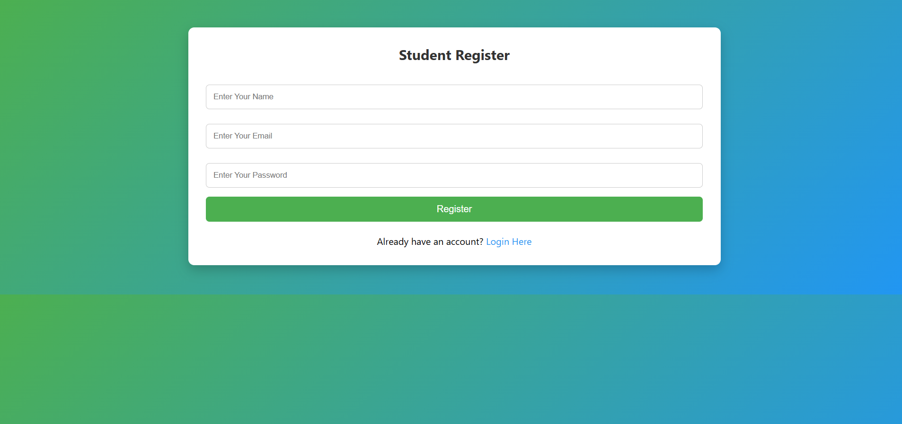
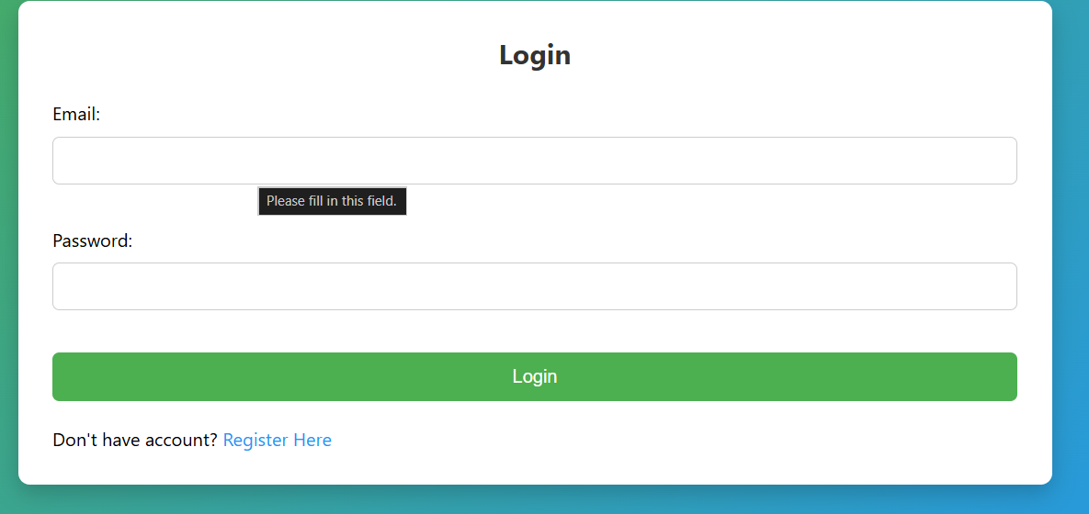
IMPLEMENTATION SCREENSHOTS
1
2
Home Page –Launches the website and provides an overview of the system features. Acts as the entry point for users, offering navigation to registration, login, and other key functionalities of the Online Exam System.
3
4
5
6
7
8
9

Slide 11
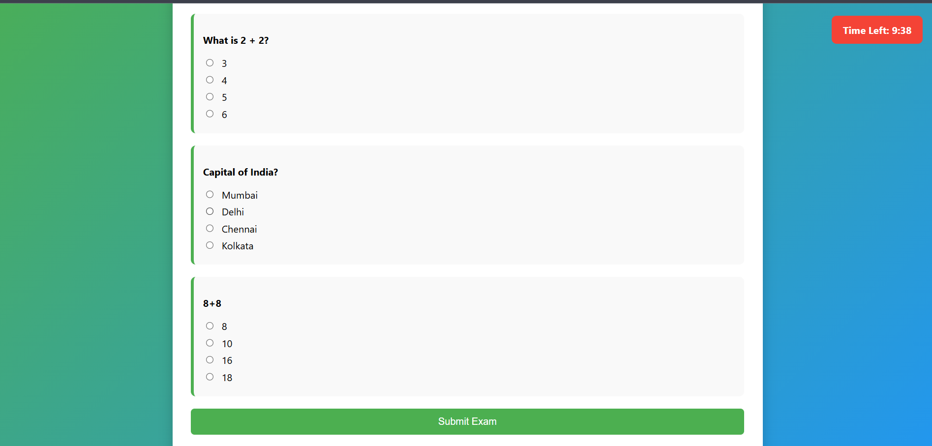
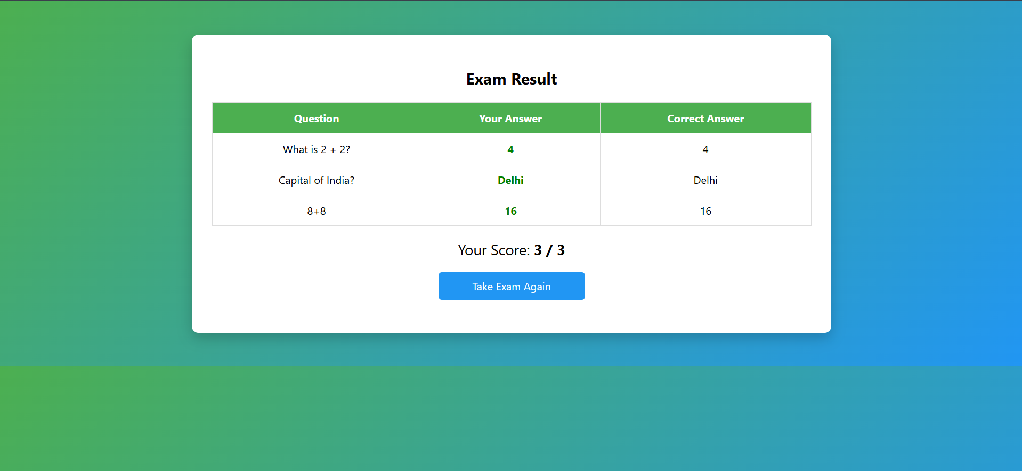
IMPLEMENTATION SCREENSHOTS
1
2
3
4
5
6
7
8(A)
9

Slide 12
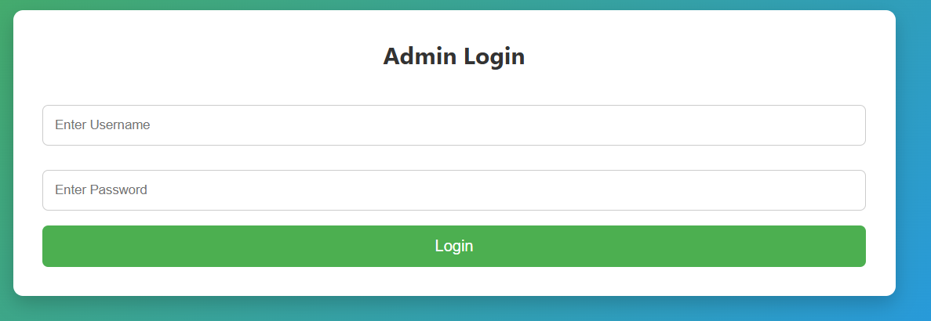
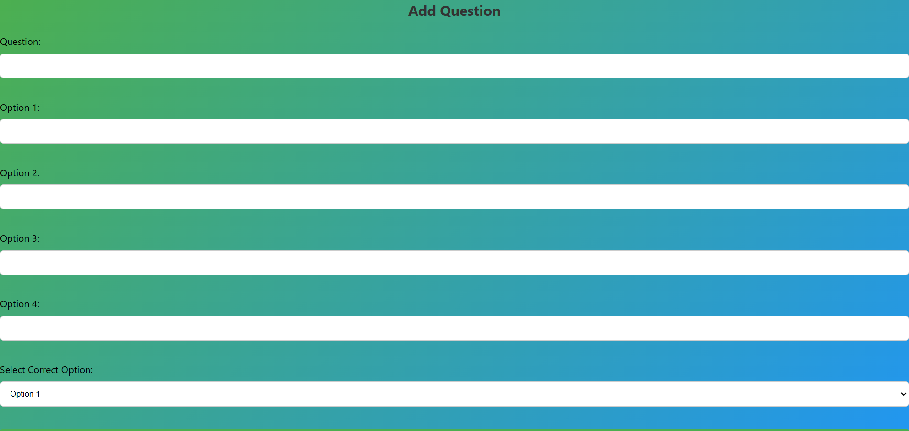
IMPLEMENTATION SCREENSHOTS
1
2
3
4
5
6
7
8(C)
9

Slide 13
ADVANTAGES & LIMITATIONS
1
Advantages
Secure Data Handling: Protects user information through session management and backend validation, reducing risks like unauthorized access and SQL injection.
Real-time Evaluation: Automatically calculates scores and displays results instantly after exam submission, improving efficiency.
Efficient Exam Logic: Streamlines the entire exam process with timer-based execution, dynamic question loading, and automatic submission.
Limitations
Limited Security Features: Does not include advanced proctoring (like webcam monitoring or AI-based cheating detection).
No Offline Mode: Requires continuous internet connection and server availability to conduct exams.
Basic Result Analysis: Provides only score calculation without advanced analytics or performance insights.
Scalability Constraints: Designed for small-scale use; may require cloud infrastructure for handling large numbers of users.
2
3
4
5
6
7
8
9

Slide 14
Thank you

